Slide 1
Continuum of Care (CoC) Program FY 2018 Competition Informational Webinar
for the Louisiana Balance of State Continuum of Care (LA BOSCOC) Presenters: Gordon Levine (LA BOSCOC), Melany Mondello (TAC)

Slide 2
Funding Overview

Slide 3
Funding Availability
The Louisiana Housing Corporation (LHC), as the Collaborative Applicant (e.g. lead agency) for the Louisiana Balance of State Continuum of Care (LA BOSCOC), will, in September 2018, submit a consolidated application to the U.S. Department of Housing and Urban Development (HUD) requesting approximately $17 million in funding through the Continuum of Care (CoC) Program
The CoC Program funds projects that provide housing and supportive services for people experiencing homelessness
LHC will select projects to include in the consolidated application based on a competitive process
LHC will include both new and existing (e.g. renewal) projects in the consolidated application

Slide 4
Funding Amounts - Renewal
$16,272,579 is available in funding for renewal projects
All existing projects are eligible for renewal
Any existing project can choose not to submit a renewal project application; that project’s funds will be added to the General Funding Pool
Renewal projects can only apply for funding up to their FY17 amount (e.g. the amount listed on the Projects Eligible for Renewal spreadsheet)
Generally speaking, renewal projects can’t change much about their projects from FY17 to FY18 – but there are exceptions; more on that later

Slide 5
Funding Amounts – General Funding Pool (New Projects)
$976,355 is available for new projects through the General Funding Pool
Funding from this pool is available to all new project applications, including projects dedicated to serving survivors of domestic violence
Three project types can be funded through the General Funding Pool:
Permanent Supportive Housing (PSH);
Rapid Re-housing (RRH);
Joint Transitional Housing – Rapid Re-housing (TH-RRH)
Funding from this Pool is prioritized to each LA BOSCOC Region based on the number of people experiencing homelessness counted during the January 2018 Point in Time (PIT) Count; all Regions were allocated a minimum of $150,000

Slide 6
Funding Amounts – General Funding Pool (New Projects) (continued)
Funding prioritized to a given Region will be awarded to projects operating in that Region that score at least 70% during the CoC Program Local Competition
Remaining funding will be awarded to projects irrespective of their Region
The Scoring Committee may, at its discretion, award funds from this Pool to projects from the following project types:
Homeless Management Information Systems (HMIS);
Coordinated Entry (SSO-CES)

Slide 7
Funding Amounts – General Funding Pool (New Projects) – Regional Breakdown
LA BOSCOC Region | Total # of People Experiencing Homelessness | % of People Experiencing Homelessness | General Funding Pool Allocation
Baton Rouge | 353 | 61.39% | $361,485
Houma | 45 | 7.83% | $150,000
Lake Charles | 161 | 28.00% | $164,870
Natchitoches/ Sabine | 0 | 0.00% | $150,000
Plaquemines/ St. Bernard | 16 | 2.78% | $150,000

Slide 8
Funding Amounts – Domestic Violence (DV) Funding Pool (New Projects)
$366,959 is available in the Domestic Violence (DV) Funding Pool
Funding from this Pool is available exclusively to projects that assist survivors of domestic violence, dating violence, and stalking.
Funding from this Pool is equally available to all applicants irrespective of the Region in which they propose to operate
Funding from this Pool will be awarded to up to one project of EACH of the following project types:
RRH;
TH-RRH

Slide 9
Funding Amounts – Planning Grant
LHC will apply for $488,177 in Planning Grant funding
The Planning Grant funds the major non-project functions of the LA BOSCOC
In FY18, LHC projects it will fund three full time positions through the Planning Grant:
Continuum of Care Manager (Gordon Levine);
Continuum of Care Coordinator (TBD);
Coordinated Entry Specialist (TBD)

Slide 10
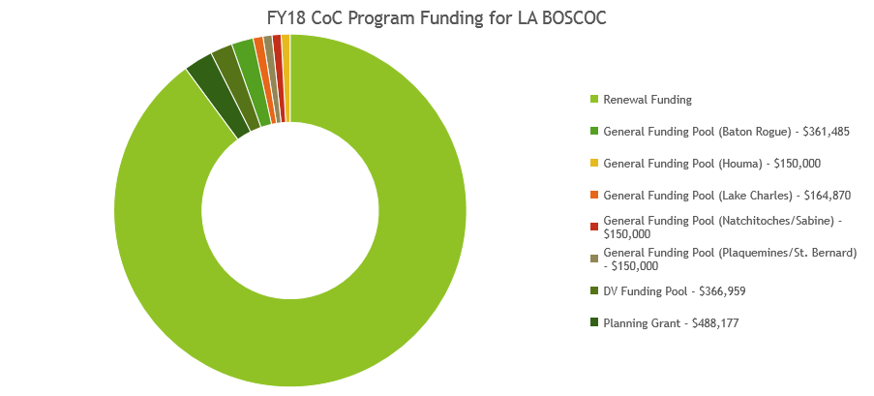
Funding Amounts - Visualization

Slide 11
Continuum of Care Overview

Slide 12
What is a Continuum of Care?
Continuums of Care (CoCs) are coalitions of organizations and individual people dedicated to ending homelessness
There are more than 400 CoCs across the United States and its territories
Each CoC covers its own collection of counties/parishes; some CoCs only cover one county/parish, others cover many
HUD laid the foundation for CoCs in 1994 when it started requiring communities to submit one consolidated application
HUD codified the CoC structure in 2012 when it published the CoC Program Interim Rule, which outlined the basic structures and duties of a CoC

Slide 13
Continuums of Care in Louisiana

Slide 14
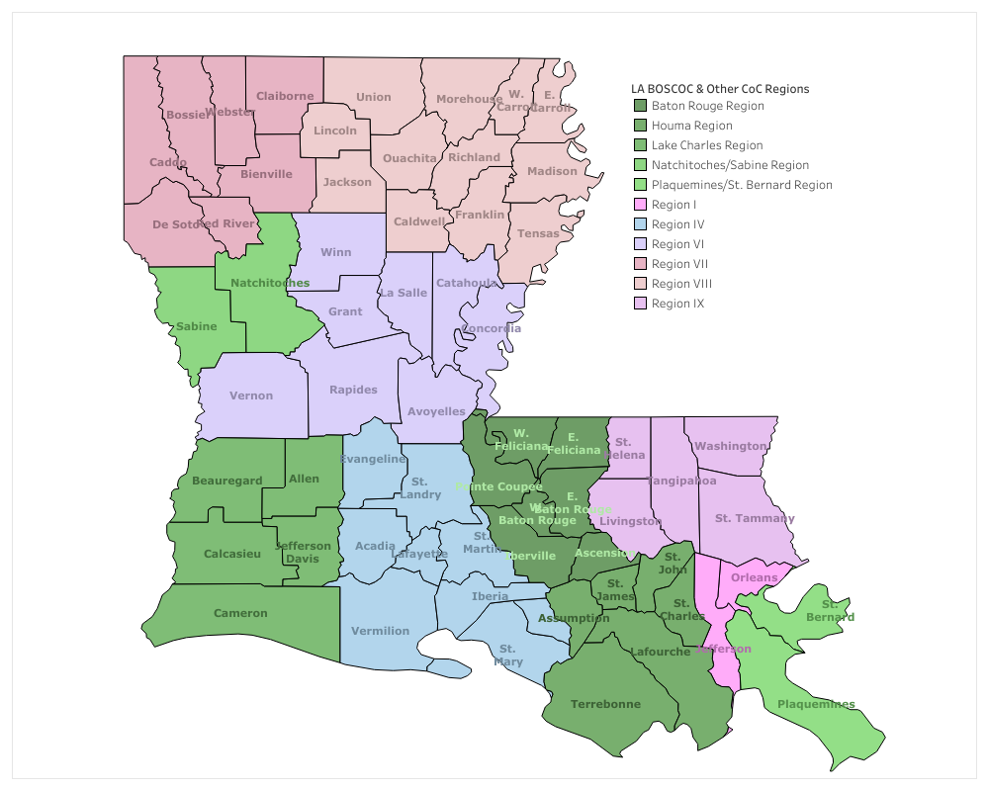
Continuums of Care in Louisiana - Map

Slide 15
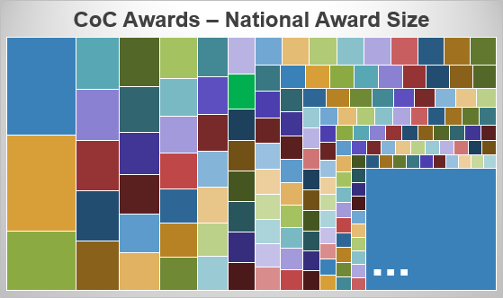
Continuums of Care - Nationally
This is the LA BOSCOC. We receive the 30th largest award in the country…
…out of ~400 total CoCs. (Here are ~300 of the smaller ones.)

Slide 16
Terminology
When we say LA BOSCOC (or “the Balance of State,” or “the BOS”), we could mean three different things:
The coalition of organizations, and their projects and activities, that are the body of the CoC; this is also called the “CoC membership”;
The parishes served by the LA BOSCOC and included in the consolidated application; this is also called the “CoC geography”;
The management and administrative team employed by LHC; this is often used interchangeably with “the LA BOSCOC,” as this team operates at the direction of the LA BOSCOC’s Board

Slide 17
Main Functions of a Continuum of Care
Big picture: according to HUD, CoCs have several primary functions:
Develop and implement a long-term plan to prevent and end homelessness in the CoC
Submit a consolidated application to the annual CoC Program Notice of Funding Availability (NOFA)
Establish a single Homeless Management Information System (HMIS) for the CoC
Report about homelessness on an annual basis through the Point in Time (PIT) Count, the Housing Inventory Chart (HIC), and individual projects’ Annual Performance Reports (APRs)
Monitor and provide technical assistance to CoC Program-funded projects
Monitor and provide technical assistance to any projects maintaining participant data in HMIS

Slide 18
Key Concepts

Slide 19
CoC Program Competition
LHC (the Collaborative Applicant) submits the LA BOSCOC’s consolidated application to the national CoC Program Competition
The consolidated application is composed primarily of project applications
The LA BOSCOC selects which projects to include in the consolidated application via scoring tools approved by the Board and by the Scoring Committee
The Scoring Committee is composed of volunteers from the Governor’s Council on Homelessness, none of whom have vested interests in any organization competing for funding
The “CoC Program Competition” refers to the national competition between CoCs and their projects; the “CoC Program Local Competition” refers to the project scoring and ranking process within the LA BOSCOC

Slide 20
Housing First
Housing First is a program model under which participants receive housing with as few pre-conditions as possible and are removed from housing under only the most extreme circumstances
All new projects are required to use the Housing First model; renewal projects receive a large number of points for using the Housing First model, and in future years will likely be required to use the Housing First Model

Slide 21
Housing First (continued)
Projects need to meet the following criteria to be considered Housing First under the FY18 CoC Program NOFA: they must
Quickly move participants into permanent housing;
Ensure that participants are not screened out based on having (1) too little or little income, (2) active or a history of substance abuse, (3) a criminal record with exceptions for state-mandated restrictions, and (4) a history of victimization, e.g. domestic violence, sexual assault, childhood abuse;
Ensure that participants are not terminated from the project for (1) failing to participate in supportive services, not including case management that is for the purposes of engagement only, (2) failing to make progress on a service plan, (3) losing income or failing to increase income, and (4) any other activity not covered in a lease agreement typically found in the project's geographic area.

Slide 22
Homeless Management Information System (HMIS)
HUD requires each CoC to use a single HMIS to record data about people experiencing homelessness
All CoC Program projects are required to record participant data in HMIS*
All CoCs in Louisiana use the same HMIS: ServicePoint
HMIS licenses in the LA BOSCOC are very inexpensive: ~$120 per person per year
* Victim services providers and legal services providers are required instead to use an HMIS-comparable database; for victim services providers funded under the FY18 CoC Program NOFA in the LA BOSCOC, that database is EmpowerDB

Slide 23
Coordinated Entry
HUD requires all CoCs to operate a Coordinated Entry System, which is a CoC-wide policy regarding how people experiencing homelessness are assessed for, prioritized for, and referred to housing and services
The LA BOSCOC’s Coordinated Entry System policies and procedures are outside the scope of this presentation, but the important points are:
Projects funded under the FY18 CoC Program NOFA must exclusively intake participants from the Coordinated Entry Prioritization List;
The Coordinated Entry Prioritization List is populated by Coordinated Entry access points; there is at least one access point in each Region;
Participants are referred from the List to projects on the basis of which participants have the highest VI-SPDAT score when the project requests a referral;
VI-SPDAT is the assessment tool used by all CoCs in Louisiana to determine participants’ level of need

Slide 24
Request for Proposals Overview

Slide 25
The Big Picture
HUD releases its CoC Program Notice of Funding Availability (NOFA) annually; nationwide, it provides $2.1 billion, the largest single grant in the federal government
HUD tells each CoC exactly how much money it can apply for
HUD requires each CoC to operate a local competition for new and renewal projects to decide how each project is ranked
HUD requires each CoC to rank its projects in order of priority to receive funding

Slide 26
The Big Picture (continued)
In addition to being ranked in order of priority, projects are separated into two funding tiers: Tier 1 and Tier 2
Tier 1 = 94% of the CoC’s Annual Renewal Demand (ARD), also known as the total amount of its renewal project funding; in other words, Tier 1 = the top 94% of the CoC’s project priority listing
Tier 2 = 6% of the CoC’s ARD plus the total amount of any bonus funding; in other words, Tier 2 = the bottom 6% of the CoC’s project priority listing

Slide 27
The Big Picture (continued)
HUD funds all Tier 1 projects before it funds any Tier 2 projects; Tier 1 projects are therefore very likely to be funded
HUD ranks all Tier 2 projects submitted by all CoCs against each other, then funds those projects in order of that ranking; Tier 2 projects are less likely to be funded
Historically, CoCs that perform well in the national CoC Program Competition are more likely to have their Tier 2 projects funded
In FY17, for the first time, the LA BOSCOC scored above both the national median and national mean; in other words, the LA BOSCOC performed well! ☺

Slide 28
Takeaways From the Big Picture
There are two funding stages: the LA BOSCOC’s Local Competition and the national CoC Program Competition
If the LA BOSCOC includes your project in the consolidated application, it doesn’t guarantee funding
If the LA BOSCOC ranks your project in Tier 1, your project is very likely to receive funding
If the LA BOSCOC ranks your project in Tier 2, your project is still competitive for funding

Slide 29
Takeaways From the Big Picture (continued)
How can you make a project application more competitive in the LA BOSCOC Local Competition?
Read the Scoring Tools Detailed Instructions carefully, and make sure you address each part of each scoring element in the corresponding section of the project application in e-snaps or in the Project Application Supplement
Write CLEARLY and write CONCISELY; the easier it is for the Scoring Committee to read and understand your project application, the easier it is for them to award you points
Consult with organizations that received new project awards in FY17; they might have words of wisdom about grant writing for the LA BOSCOC!

Slide 30
Takeaways From the Big Picture (continued)
How can you make a project application more competitive in the national CoC Program Competition?
Project applications that succeed in the LA BOSCOC’s Local Competition are well positioned for the national CoC Program Competition, because the Local Competition’s scoring criteria are derived in part from the national CoC Program Competition’s scoring criteria
Read HUD’s project application detailed instructions carefully, and make sure you address each part of each scoring element in the corresponding section of the project application
Write CLEARLY and write CONCISELY; HUD reviewers are less familiar with our organizations and communities than the LA BOSCOC scoring committee!
Whenever possible, reflect HUD’s language in your project application’s language

Slide 31
Takeaways From the Big Picture (continued)
How can you make a project application more competitive in the national CoC Program Competition?
Project applications that succeed in the LA BOSCOC’s Local Competition are well positioned for the national CoC Program Competition, because the Local Competition’s scoring criteria are derived in part from the national CoC Program Competition’s scoring criteria
Read HUD’s project application detailed instructions carefully, and make sure you address each part of each scoring element in the corresponding section of the project application
Write CLEARLY and write CONCISELY; HUD reviewers are less familiar with our organizations and communities than the LA BOSCOC scoring committee!
Whenever possible, reflect HUD’s language in your project application’s language

Slide 32
Project Types and Eligible Activities

Slide 33
Process Overview
Organizations create their project applications in e-snaps, HUD’s online grant management platform
Organizations fill out the LA BOSCOC’s Project Application Supplement in Word or a compatible word processor
Organizations submit their project applications and Project Application Supplements by email to the LA BOSCOC by the due date listed in the RFP
The LA BOSCOC Scoring Committee scores and ranks project applications for inclusion in the consolidated application
Projects selected for inclusion finalize their applications in e-snaps (“hit the Submit button”) by the date listed in the RFP
All of these dates and times are listed at the end of this webinar and in the RFP.

Slide 34
What Projects Can the CoC Program Fund – Renewal
Renewal projects must apply to be funded under their existing project type
…unless they intend to transition into a different project type*
This is a new feature in FY18, and we don’t know much about it yet
No renewal projects have indicated that they intend to transition between project types
Organizations that would like to transition a project need to contact the Continuum of Care Manager ASAP
* For more information, see Page 8 of the FY18 CoC Program NOFA

Slide 35
What Projects Can the CoC Program Fund – New Projects (General Funding Pool)
New projects applying under the General Funding Pool – which can fund projects serving all eligible target populations, including survivors of domestic violence – can apply under the following project types:
Permanent Supportive Housing (PSH): serves people experiencing chronic homelessness or those who meet the DedicatedPLUS definition*
Briefly: chronic homelessness means a person who is experiencing literal homelessness continuously for at least 12 months or on 4 separate occasions in the last 3 years where the occasions total at least 12 months AND where the adult head of household (or, if there is no adult in the family, a minor head of household) has a disability
PSH can fund housing, supportive services; no limit to the length of time participants can remain in the project
*See NOFA for definition of Dedicated Plus
Notes:
Chronically homeless means:
(1)A “homeless individual with a disability,” as defined in the Act, who:
Lives in a place not meant for human habitation, a safe haven, or in an emergency shelter; and
Has been homeless (as described above) continuously for at least 12 months or on at least 4 separate occasions in the last 3 years where the combined occasions must total at least 12 months
Occasions separated by a break of at least seven nights
Stays in institution of fewer than 90 days do not constitute a break
(2) An individual who has been residing in an institutional care facility for fewer than 90 days and met all of the criteria in paragraph (1) of this definition, before entering that facility; or
11
(3) A family with an adult head of household (or if there is no adult in the family, a minor head of household) who meets all of the criteria in paragraphs (1) or (2) of this definition, including a family whose composition has fluctuated while the head of household has been homeless.

Slide 36
What Projects Can the CoC Program Fund – New Projects (General Funding Pool) (cont’d)
Rapid Re-housing (RRH): serves people who qualify under ANY ONE of the following:
Experiencing literal homelessness;
Fleeing domestic violence, dating violence, or stalking;
Are residing in a transitional housing (TH) project that was eliminated;
Are residing in a TH unit funded by a Joint Transitional Housing-Rapid Re-housing (TH-RRH) project;
Are receiving services through a Veterans Affairs (VA)-funded homeless assistance program AND met one of the other above criteria at initial intake to the VA’s homeless assistance system
Participants can stay up to 24 months; best practices and upcoming LA BOSCOC standards will encourage stays of 3-12 months and set strict, clear criteria for stays longer than 12 months

Slide 37
What Projects Can the CoC Program Fund – New Projects (General Funding Pool) (cont’d)
TH-RRH: serves people who qualify under ANY ONE of the following:
Experiencing literal homelessness;
Fleeing domestic violence, dating violence, or stalking;
Are residing in a transitional housing (TH) project that was eliminated;
Are residing in a TH unit funded by a Joint Transitional Housing-Rapid Re-housing (TH-RRH) project;
Are receiving services through a Veterans Affairs (VA)-funded homeless assistance program AND met one of the other above criteria at initial intake to the VA’s homeless assistance system
Provides BOTH transitional housing AND rapid re-housing components; this project model is challenging and relatively new; it is most likely effective in very rural areas and with youth populations; if you are considering a TH-RRH project, please contact the CoC Manager separately

Slide 38
What Projects Can the CoC Program Fund – New Projects (DV Funding Pool)
New projects applying under the DV Funding Pool – which can exclusively fund projects that “assist survivors of domestic violence, dating violence, and stalking” – can apply under the following project types:
RRH: serves only people who are survivors of domestic violence, dating violence, and stalking; participants can stay up to 24 months; best practices and upcoming LA BOSCOC standards will encourage stays of 3-12 months and set strict, clear criteria stays longer than 12 months
TH-RRH: serves only people who are survivors of domestic violence, dating violence, and stalking; provides BOTH transitional housing AND rapid re-housing components; this project model is expensive, challenging, and relatively new; it is most likely effective in very rural areas and with youth populations; if you are considering a TH-RRH project, please contact the CoC Manager separately

Slide 39
Eligible Costs
The following cost categories are eligible under the CoC Program Local Competition:
Leasing
Rental Assistance
Supportive Services
Operating Costs
Homeless Management Information System (HMIS)
Project Administrative Costs
All of those cost categories are detailed in 24 CFR 578.49 through 24 CFR 578.59

Slide 40
Ineligible Costs
The following project cost categories listed in 24 CFR Part 578, Subpart D are ineligible under the CoC Program Local Competition:
Acquisition
Rehabilitation
New Construction
Relocation Costs
Indirect Costs

Slide 41
Eligible Costs by Project Type
Not all costs are eligible for all project types. Consult the chart below to determine whether a given cost category is eligible for a given project type.
Eligible Costs | PSH | RRH | TH-RRH | TH | SSO | HMIS
Leasing | X |  | X | X
Rental Assistance | X | X | X | X
Supportive Services | X | X | X | X | X
Operating Costs | X |  |  | X
HMIS | X | X | X | X | X | X
Administration | X | X | X | X | X | X

Slide 42
Eligible Costs: Details
Leasing
Pays for leasing space to provide housing or supportive services
Cannot be used to lease structures owned by the recipient or sub-recipients
Rental Assistance
Subsidies provided to participants to help them achieve or maintain housing
Duration of subsidies vary depending on project type
Can be tenant-based (moves with participant) or project-based (stays with the unit); however, RRH can only be tenant-based
Can pay for rent, security deposits (up to 2x rent), and damages (up to equivalent of one month’s rent; RRH can’t pay damages)

Slide 43
Eligible Costs: Details (continued)
Supportive Services
Services listed in the CoC Program interim rule that addresses a given participant’s specific need that must be met so they can achieve and maintain permanent housing
Each project type has a specific term during which supportive services must be provided to participants
Specifically Eligible Supportive Services (list is not all-inclusive)
Annual assessments of participant needs
One-time moving costs
Case management (very broadly defined)
Child care
Education services

Slide 44
Eligible Costs: Details (continued)
Specifically Eligible Supportive Services (continued)
Employment assistance and job training
Legal services
Life skills
Mental health services
Outpatient health services (note: inpatient services are NOT eligible)
Outreach
Substance abuse treatment services (note: inpatient services are NOT eligible)
Transportation
Utility deposits

Slide 45
Eligible Costs: Details (continued)
Specifically Eligible Supportive Services (continued)
Costs incurred by the recipient or sub-recipient directly providing any eligible activity under Supportive Services, including staff salaries/benefits and supplies/materials

Slide 46
Eligible Costs: Details (continued)
Operating Costs
Day-to-day costs of operating transitional or permanent supportive housing in a single structure or individual housing units
Includes maintenance/repair, taxes/insurance, utilities, and furniture
Note: projects CANNOT fund both Rental Assistance and Operating Costs in the same project
HMIS
Costs associated with contributing data to HMIS or to an HMIS-comparable database
Includes equipment and software licenses
Includes staff time to enter data – which is NOT eligible under other cost categories!

Slide 47
Eligible Costs: Details (continued)
Administrative Costs
New projects can designate up to 10% of their CoC Program funds for use as Administrative Costs
Renewal projects must use the same amount of Administrative Costs as in FY17, but may amend their FY18 grant once they’re executed to increase their Administrative Costs percentage up to 10%
Pays for overall program management, coordination, monitoring, and evaluation
Specific common Administrative Costs include salaries/benefits/equipment costs etc. for budgeting and accounting, program administration, and grant reporting

Slide 48
Project Scoring

Slide 49
Overview
Projects are divided into two categories for scoring: new projects (from all new project funding pools) and renewal projects
New projects are scored primarily on their project application, its narratives, and the organization’s demonstrated capacity to implement the project
Renewal projects are scored primarily on their previous year’s performance data
Renewal projects whose FY16 grant periods ended on or before December 31, 2017 are scored on their FY16 performance data;
Renewal projects whose FY16 grant periods ended on or after January 1, 2018 are scored on their FY15 performance data

Slide 50
Threshold Criteria
Both new and renewal projects are evaluated based on threshold criteria
Projects that don’t meet ALL the threshold criteria are disqualified from the Local Competition and not scored

Slide 51
New Project Threshold Criteria
Eligible Applicant: is the applicant a non-profit organization, local government, or instrumentality of a local government?
Eligible Population: will the project serve an eligible population under its project type?
Eligible Activities: will the project engage exclusively in eligible activities?
Match Requirement: will the project provide matching funds equal to at least 25% of its CoC Program funds (excluding any funds requested under leasing)?

Slide 52
New Project Threshold Criteria (continued)
Coordinated Entry: does the project commit to intake participants exclusively through Coordinated Entry?
HMIS or HMIS-Comparable Database: does the project commit to maintain data in HMIS or an HMIS-comparable database?
DV providers must use EmpowerDB as their HMIS-comparable database
Housing First: does the project qualify as using the Housing First model?

Slide 53
New Project Threshold Criteria (continued)
Good Standing: is the project’s organization in Good Standing with the LA BOSCOC? There are two requirements for Good Standing:
At least one staff person from the organization attended at least 3 of the 4 most recent LA BOSCOC General Meetings;
At least one staff person from the organization is an active member of at least one LA BOSCOC committee, subcommittee, working group, or the LA BOSCOC Board
Note: organizations that do not meet the Good Standing requirement may request a waiver; to request a waiver, please email the Continuum of Care Manager

Slide 54
New Project Scoring Elements
Refer to the New Project Scoring Tool and Scoring Tool Detailed Instructions for comprehensive information about new project scoring elements
The following is a list of significant changes to new project scoring elements in FY18:

Slide 55
New Project Scoring Elements (continued)
Project Beds Dedicated to Chronically Homeless/DedicatedPLUS: point value reduced from 6 to 2
Rural Parishes: projects operating exclusively in rural parishes receive 4 points
Outreach:
Projects are required to explain how their outreach integrates into their LA BOSCOC Region’s broader outreach network;
Projects receive 0 points in this category if they do not employ at least 0.5 FTE outreach workers

Slide 56
New Project Scoring Elements (continued)
Cost Effectiveness: projects now receive up to 6 points for projected cost effectiveness (e.g. projected cost per participant)
CoC Participation: projects now receive 2 points if their organization participated in both the January 2018 PIT Count and the 2018 HIC
Voluntary Reallocation Bonus: projects receive 6 points if their organization voluntarily reallocated a different existing CoC Program project that was eligible for renewal in FY18

Slide 57
Renewal Project Threshold Criteria
Identical to New Project Threshold Criteria, EXCEPT:
Housing First is not a Threshold Criteria for renewal projects; instead, for FY18, it is a scoring element with a large number of points associated

Slide 58
Renewal Project Scoring Elements
Refer to the Renewal Project Scoring Tool and Scoring Tool Detailed Instructions for comprehensive information about renewal project scoring elements
The following is a list of significant changes to renewal project scoring elements in FY18:
Project Beds Dedicated to Chronically Homeless/DedicatedPLUS: point value reduced from 6 to 2
Rural Parishes: projects operating exclusively in rural parishes receive 4 points

Slide 59
Renewal Project Scoring Elements (continued)
Utilization Rate: projects receive up to 6 points based on their utilization rate (e.g. the number of participants housed on the HIC date divided by the number of beds proposed in that year’s project application)
Cost Effectiveness: projects receive up to 6 points based on their cost effectiveness (based on total project budget less supportive services divided by total number of stayers and leavers to permanent housing)
Safety Improved (DV projects only): projects receive up to 6 points based on the number of participants who reported their safety improved

Slide 60
Renewal Project Scoring Elements (continued)
Fiscal and Programmatic Stability: projects receive up to 6 points if they had no outstanding Findings in their most recent LA BOSCOC monitoring and if they had no outstanding issues or concerns on their most recent financial audit

Slide 61
Project Ranking and Priority Listing

Slide 62
Overview
Full details can be found on Pages 6-7 of the LA BOSCOC Project Rating, Ranking, and Selection document
Generally speaking:
Renewal projects are prioritized ahead of new projects;
PSH and RRH are prioritized ahead of TH-RRH, which is prioritized ahead of TH;
Housing projects are prioritized ahead of HMIS and SSO projects

Slide 63
Words of Wisdom: Writing Grants for the LA BOSCOC and HUD

Slide 64
General Writing Advice
Use People First Language, e.g. “people experiencing homelessness” rather than “homeless people”
Whenever Possible, Speak HUD. Try to reflect the language HUD uses in the FY18 CoC Program NOFA, e.g. “participant” instead of “client.”
Use Correct Terminology. SHP no longer exists; use CoC Program instead. Correctly name your project types: permanent supportive housing, rapid re-housing, etc.

Slide 65
Common Mistakes/Best Practices
Applying for non-eligible costs. A big offender here is applying for shelter beds; the CoC Program does NOT fund emergency shelter.
Applying for eligible costs under the wrong category. The main offender here is applying for eligible admin costs under another budget category (which makes them ineligible).
Applying to serve a non-eligible population. CoC Program projects CANNOT serve people who are at risk of homelessness; CoC Program projects are restricted to some combination of people experiencing literal homelessness and/or people fleeing domestic violence.

Slide 66
Common Mistakes/Best Practices (continued)
PSH projects attempt to serve people who do not have a disability. In addition to meeting all homelessness criteria, PSH participants MUST have a verified disability.
Project application is inconsistent in how it describes project design, target population, and number of households/participants it will serve. Most elements of the project application have both narrative and data components, and those components need to agree with each other – e.g. if your data shows you’re serving 10 people from the youth population, your narratives need to say the same thing.

Slide 67
Common Mistakes/Best Practices (continued)
HUD releases two sets of instructions for the project application: the question list and the detailed instructions. Answer ALL of the elements listed in the detailed instructions for EACH question. If the detailed instructions ask you to describe (1) community needs, (2) target population to be served, and (3) project plan to address housing, answer ALL of those questions – in that order.
Clearly indicate which part of the question you’re answering. If a question asks you to “describe the target population to be served,” format your answer like, “This project will serve the following target population…”

Slide 68
Common Mistakes/Best Practices (continued)
Narratives talk about your agency’s functions rather than your project’s plans. The LA BOSCOC and HUD are mostly interested in your project; only include enough information about your agency to establish your bona fides.
Match letter is from the applicant, NOT from the agency providing the match. If Acme Agency is applying for RRH and Beta Bank is providing the match, the match letter needs to be from Beta Bank.
Budget isn’t reasonable. Don’t over- or under-ask for anything. LA BOSCOC wants projects that will meet participants’ needs and viably help them achieve permanent housing.

Slide 69
Common Mistakes/Best Practices (continued)
Project requests less than 10% admin. Unless you have a very good reason not to, request the maximum amount of admin; there is no benefit to requesting less.
Project doesn’t request HMIS funds. All projects are required to enter data into HMIS. Entering data into HMIS is only an eligible activity under the HMIS budget category. Make sure you fund your staff to do this work!

Slide 70
LA BOSCOC and HUD Links

Slide 71
LA BOSCOC and HUD LINKS
All LA BOSCOC application materials and supplemental documents can be found online at https://laboscoc.org/fy18-coc-program-competition
All HUD application materials and supplemental documents can be found online at https://www.hudexchange.info/programs/e-snaps/fy-2018-coc-program-nofa-coc-program-competition/#nofa-and-notices
e-snaps, which is HUD’s online grant platform (e.g. where you create your project applications), can be found online at https://esnaps.hud.gov/grantium/frontOffice.jsf

Slide 72
Key Dates

Slide 73
Key Dates
Jul 25: LA BOSCOC hosts Q&A conference call from 1:30 PM to 3:00 PM
Aug 2: LA BOSCOC hosts Q&A conference call from 1:30 PM to 3:00 PM
AUG 16: PROJECT APPS DUE TO LA BOSCOC BY 4 PM CST; project application (exported from e-snaps) and project application supplement must be emailed to glevine@lhc.la.gov
SEPT 4: ALL ACCEPTED PROJECTS MUST BE FINALIZED AND SUBMITTED TO HUD IN E-SNAPS

Slide 74
Questions?
You can also email questions – and requests for Good Standing waivers – to Gordon Levine, Continuum of Care Manager, at glevine@lhc.la.gov

